Slide 1
Quiet-window profiling for capsules
Profile each Capability Capsule alone on the GB10, then use the records to schedule busy runs
Workload profiling: evidence and recommendations
Notes:
TIME 0:20
SAY: Main points:
- This is the case for running each capsule alone on the DGX Spark and keeping a profile record
- Then we use those records to predict and schedule the busy runs

Slide 2
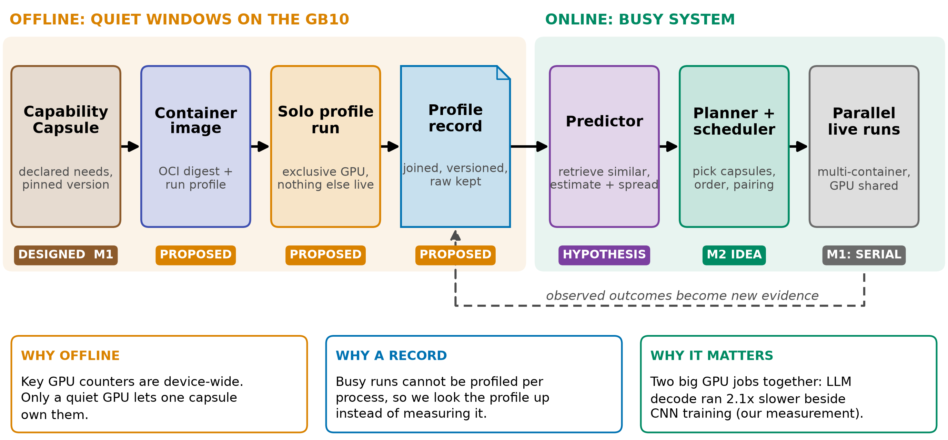
THE PROPOSAL
Profile alone, store the record, predict the busy runs
Design: gb10-profiling-plan.md; planner hooks: design-package/reference/run-plan.md
2
Notes:
TIME 1:30
SAY: Main points:
- Offline: a pinned container runs one capsule on an idle GB10 and we record everything
- The record joins the capsule version, image digest, machine state and measured outcome
- Online: a predictor looks up similar records and gives demand plus uncertainty to the planner
- Status chips are honest: only the declaration is designed in M1, the rest is proposed
- Why: device-wide GPU counters cannot be split per process while other jobs run
Supplemental points:
- The sidecar benchmark runner exists in design but does not authorize this profiler (D36, D40)
- Goal beyond scheduling: records feed chip-development questions later

Slide 3
WHY QUIET WINDOWS
Key GPU counters are device-wide: profile on a quiet GPU
Tool | Scope | What it gives | Limit that forces quiet windows
nvidia-smi / NVML | device, process list | util, memory, power, clocks, encoder | No kernel or pipe detail. On GB10: Memory-Usage Not Supported
DCGM profiling | whole device | SM, tensor, FP, DRAM, PCIe, NVLink activity | Averages, 1 Hz default. Conflicts with Nsight. No kernel or instruction
Nsight Systems | process timeline | kernels, copies, overlap, launch gaps | Intrusive, so timing-only runs stay separate
Nsight Compute | per kernel | stalls, cache, occupancy, DRAM bytes | Replay perturbs the run
cgroup v2 + PSI | per container | CPU, memory, I/O, pressure | Host resources only, never SM attribution
AWS, Google and Azure all ship DCGM or nvidia-smi device metrics: the industry default is device-level plus labels
NVIDIA DCGM user guide (feature overview); DGX Spark known issues; AWS CloudWatch, GKE, AKS docs
3
Notes:
TIME 1:15
SAY: Main points:
- DCGM itself says its profiling counters conflict with Nsight and are device-level
- Clouds collect the same device metrics, so per-process GPU truth is not on offer anywhere
- That is the reason to own the GPU: one capsule, everything measured belongs to it
Supplemental points:
- GKE attaches container, pod and namespace labels to DCGM metrics
- DCGM profiling support on GB10 is a preflight check, not assumed

Slide 4
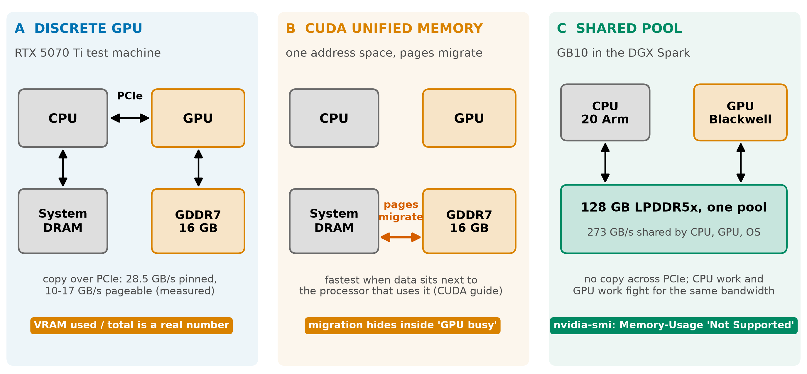
DGX SPARK
On GB10 the GPU shares one pool and dashboards go blind
NVIDIA DGX Spark hardware and known issues pages; CUDA programming guide (unified memory); copy speeds: our report
4
Notes:
TIME 1:15
SAY: Main points:
- Discrete card: VRAM is a number, PCIe copies are measurable
- Unified Memory on a discrete card: pages migrate and hide inside GPU busy
- GB10: 128 GB LPDDR5x at 273 GB/s shared by CPU, GPU and OS, so CPU work competes for bandwidth
- NVIDIA documents nvidia-smi Memory-Usage as Not Supported on iGPU, use MemAvailable instead
- Our numbers come from the discrete card and do not transfer to the GB10
Supplemental points:
- cudaMemGetInfo can understate allocatable memory because swap can be reclaimed
- Discrete-versus-GB10 differences cannot be credited to unified memory alone

Slide 5

OUR MEASUREMENTS
LLM decode runs x2.08 slower beside CNN training
• LLM decode x2.08 beside CNN training, x2.27 beside another LLM
• Training slows only x1.16: long kernels hold the GPU
• Speech-to-text and NVENC stay within x1.02 to x1.12 of solo
• Pair by hardware used, not by what the DAG allows
• n=2 per pair, n=8 for LLM+LLM. n/a = not run
Our measurements, RTX 5070 Ti, n=2 to 12, unaudited: sources/2026-10-16-shared-gpu/report.md (Fig. 6, table B.2)
5
Notes:
TIME 1:00
SAY: Main points:
- Four task types, every pairing, each compared with its own solo run
- LLM decode issues about 7 microsecond kernels with pauses, so it loses its turn to long training kernels
- Spread between runs is large for LLM beside training: x1.7 to x2.4 over two runs
Supplemental points:
- Repeat counts are small, shapes should carry over, absolute values belong to this card

Slide 6
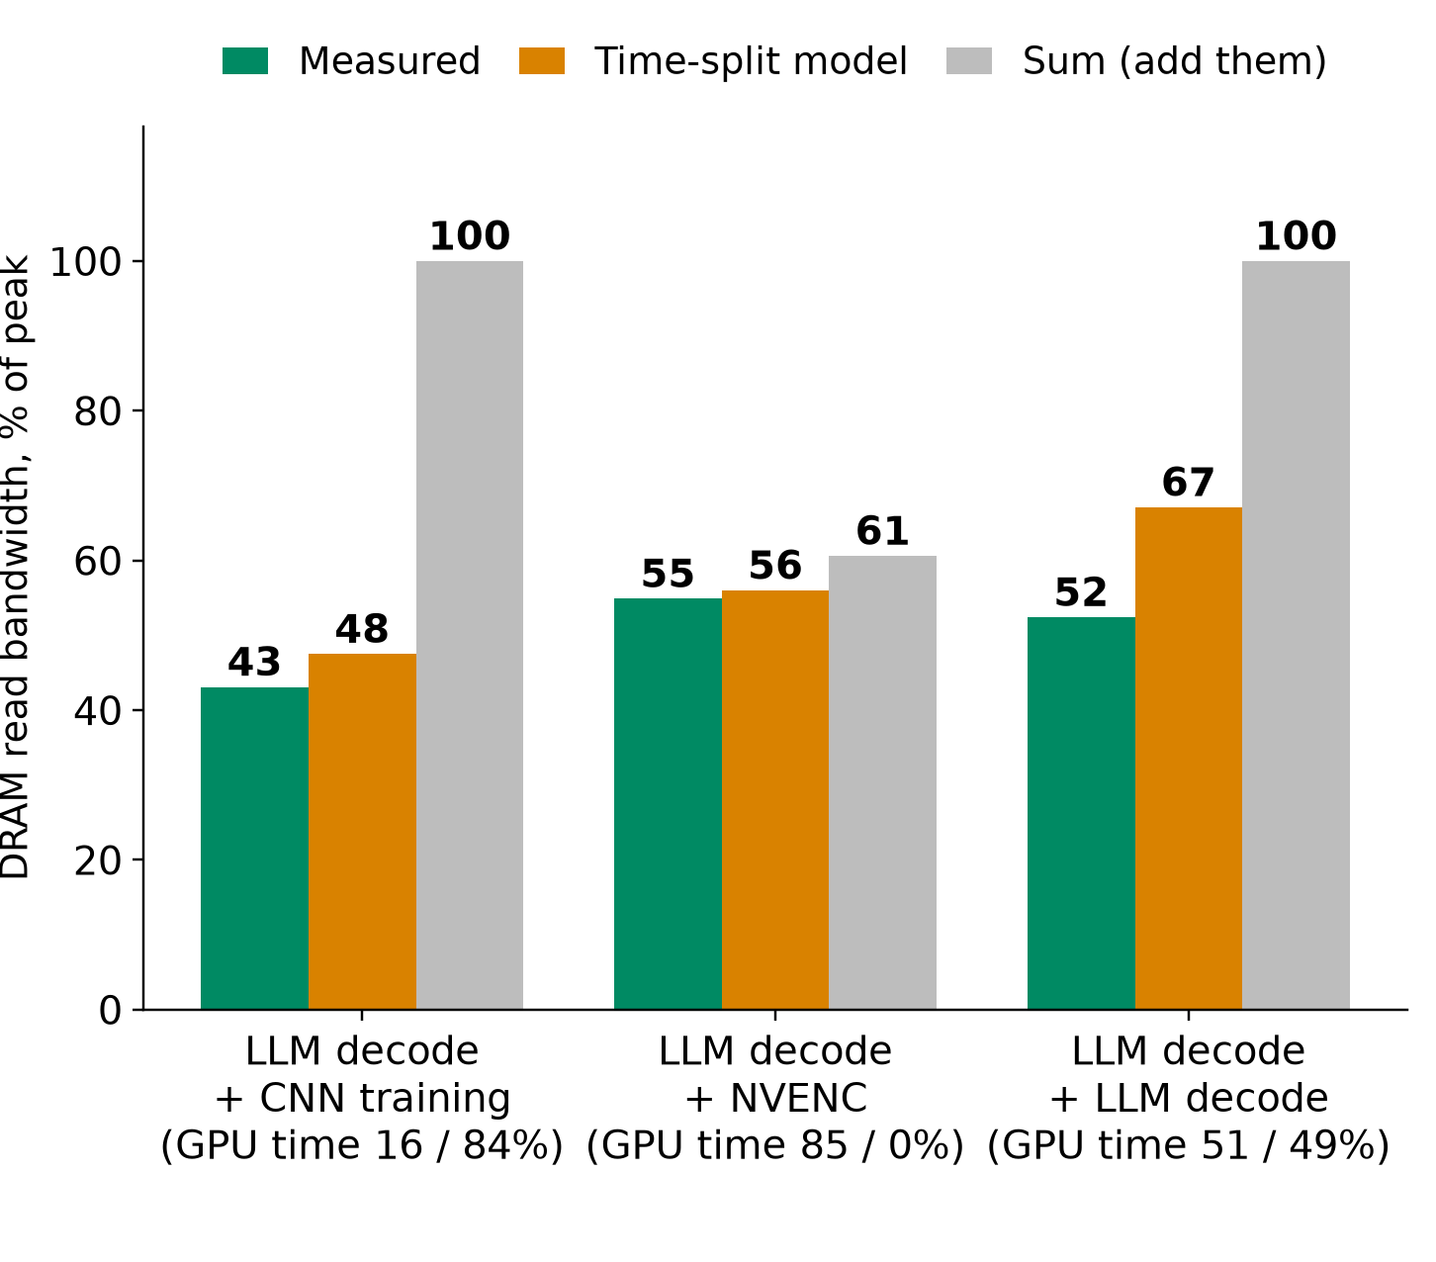
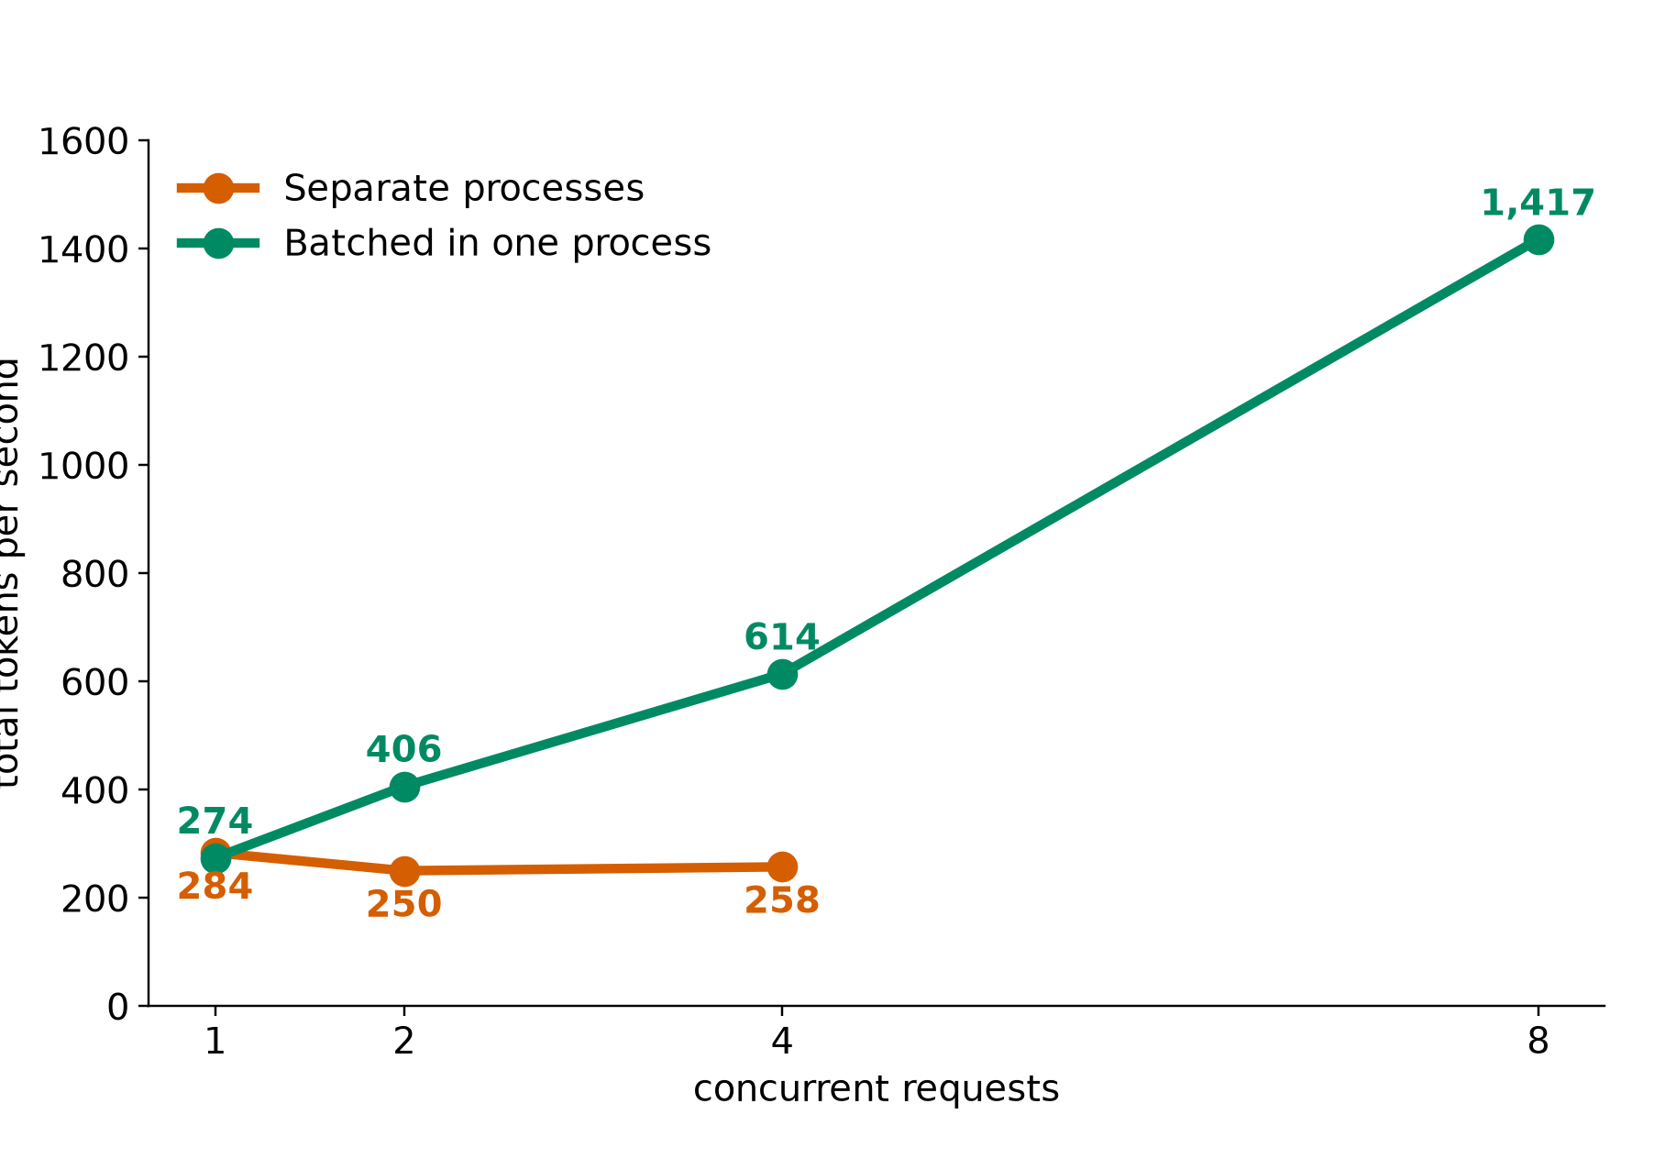
OUR MEASUREMENTS
GPUs take turns; one batching process beats four
4 separate processes: 258 tok/s. Same 4 requests batched: 614. Memory 8.9 vs 2.5 GiB
Weight solo profiles by GPU time share and subtract 2 to 22% switching loss. Never sum them
Our measurements, RTX 5070 Ti, n=2 to 12, unaudited: sources/2026-10-16-shared-gpu/report.md (Fig. 2, 3, 4; tables B.1, B.6). MPS was not tested
6
Notes:
TIME 1:15
SAY: Main points:
- Left: DRAM read bandwidth of A+B measured, from the time-split model, and from summing
- Time-split is close, measured falls below it by switching cost
- Right: qwen2.5 3B, 256 tokens, separate processes lose to batching
- Industry check: NVIDIA MPS exists to cut context switching between processes, and GKE offers it
- Open question: how much of the switching cost MPS removes
Supplemental points:
- Switching cost: 9% LLM+training, 2% LLM+NVENC, 22% LLM+LLM on DRAM read

Slide 7
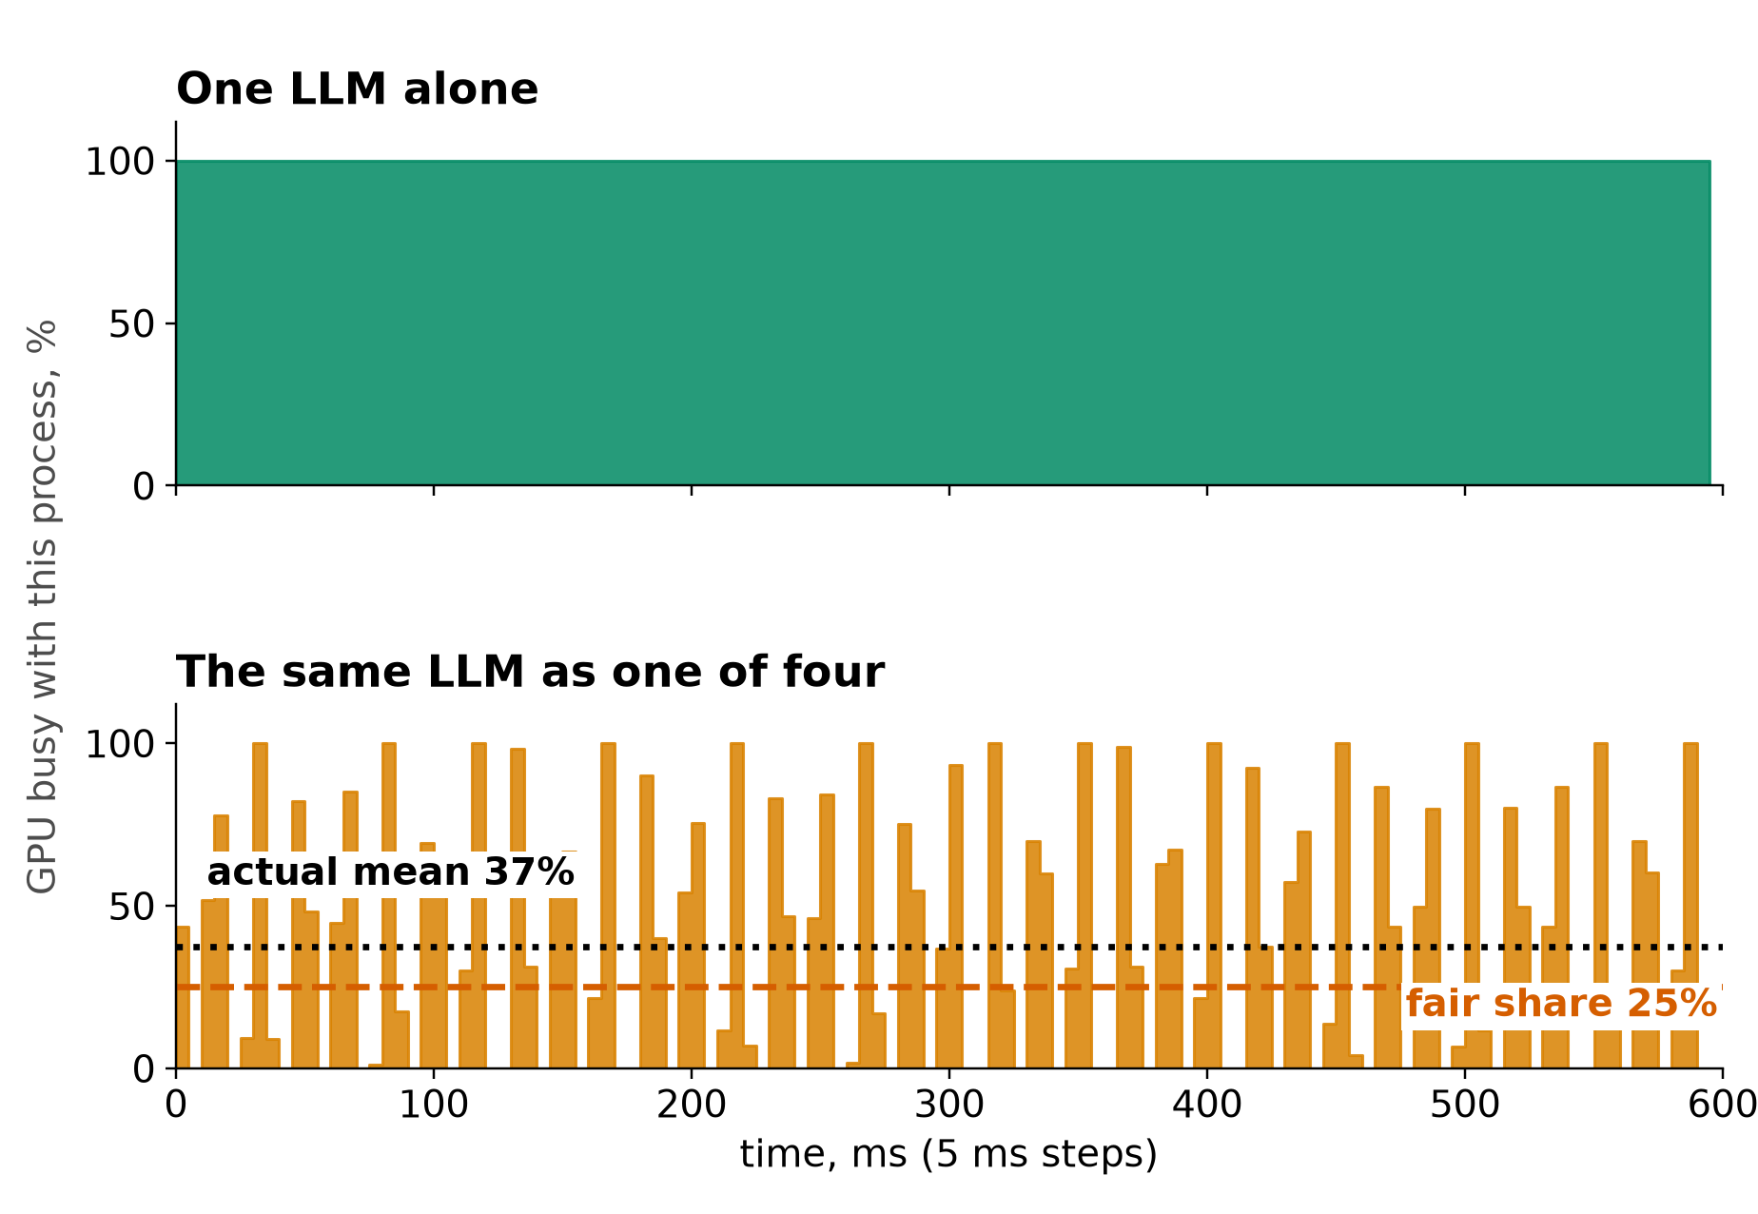
OUR MEASUREMENTS
One LLM of four gets 37% of the GPU, in bursts, not 25%
• Alone: 100% busy, 3.5 ms per token
• One of four: 37% mean, swings 0 to 100% every 5 ms, 15.8 ms per token
• The GPU switches between processes, it never splits 25% each
• Total output: 4 processes 258 tok/s vs one 284
• Treat the cost as discrete-GPU data until the GB10 is measured
Our measurements, RTX 5070 Ti, n=2 to 12, unaudited: sources/2026-10-16-shared-gpu/report.md (Fig. 7, table B.1). Discrete card: the switching cost may differ on unified memory
7
Notes:
TIME 1:00
SAY: Main points:
- One of four identical LLM processes, kernel trace, 600 ms in 5 ms steps
- Alone it keeps the GPU 100% busy, as one of four it averages 37% and flickers
- Each token takes 4.5x longer and the four together make less than one alone
- Do not read this as unified-memory behavior, it is a discrete RTX 5070 Ti
Supplemental points:
- 37% is the mean of the plotted window, the report caption also gives 37%

Slide 8

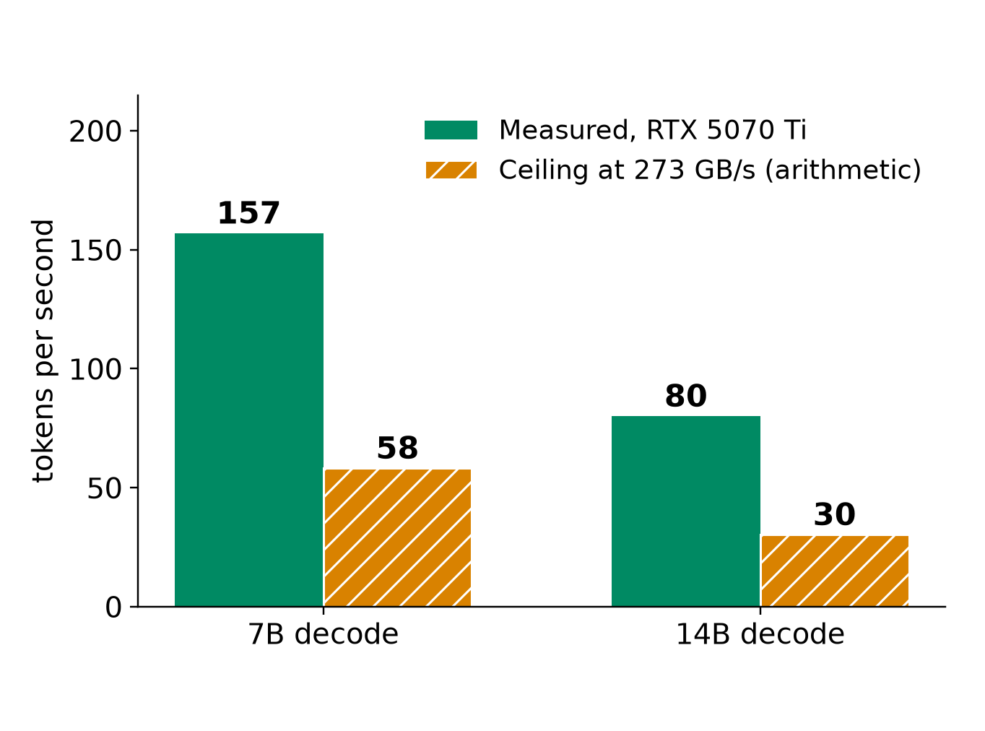
MODEL ROUTING
Router: few resident models, one batching server
Each copy takes its own weights. On the GB10 they come out of the pool the experiments also use
Load a new model only if the gain beats a cold load: 6.1 s from disk vs 0.05 s resident (7B)
Our measurements, RTX 5070 Ti, n=2 to 12, unaudited: sources/2026-10-16-shared-gpu/report.md (tables B.1, B.3, B.8). Ceiling = measured bytes per token (decode GB/s over tok/s) into 273 GB/s listed for GB10: arithmetic, not measured
8
Notes:
TIME 1:15
SAY: Main points:
- Left: 4 separate processes held 8.9 GiB, batching 4 requests held 2.5 GiB
- Right: 7B decode read about 4.7 GB per token, so 273 GB/s allows at most about 58 tok/s, 14B about 30
- The ceiling assumes decode stays bandwidth-bound and CPU work does not share the bandwidth, both unmeasured on GB10
- Router rule: prefer one good large model plus a small one, keep them resident, batch requests
- Today the router is behind RouterPort with a fixed route, this is input for later phases
Supplemental points:
- Fewer and smaller models leave pool memory for training and experiments
- Models in the pool slow every other job through shared bandwidth, expected not measured

Slide 9
WHAT YOU CAN SEE
Checking GPU load: AWS vs DGX Spark
Platform | How you check | What you see | What you cannot isolate
AWS EC2 | CloudWatch agent, nvidia_gpu block | nvidia_smi_utilization_gpu (share of time kernels ran), memory, PCIe, encoder | Which process or model caused the load
AWS EKS | Container Insights, DCGM exporter via add-on | node_gpu_utilization, node_gpu_memory_utilization, pod_gpu_utilization | Bandwidth or SM share between pods on one GPU
AWS ECS | Container Insights on Managed Instances | GPU metrics per container, task, instance. No extra agent | Same: time-based, not per kernel
Google GKE | DCGM to Managed Prometheus | 21 metrics incl. tensor, FP, DRAM activity, labelled by pod | Kernel or instruction cause
DGX Spark | nvidia-smi, /proc/meminfo, DCGM if supported, Nsight | Per-process GPU memory. Pool via MemAvailable. Memory-Usage: Not Supported | Per-process bandwidth or SM share, a GPU-only memory number
Example: 4 LLM processes still read busy (solo 3B decode is already 91% busy), yet each token took 4.5x longer
AWS CloudWatch agent NVIDIA GPU, Container Insights EKS and ECS Managed Instances docs; GKE DCGM metrics page; NVIDIA DGX Spark known issues; our report B.4, B.1
9
Notes:
TIME 1:15
SAY: Main points:
- Every cloud path gives device or pod level time-based metrics
- The many-LLM slowdown does not show as a drop in utilization
- On the Spark the pool is read from the OS, GPU memory used and total is not available from nvidia-smi
- Per-process bandwidth and SM share are the things we cannot isolate while others run, hence quiet windows
Supplemental points:
- DCGM profiling on GB10 is a preflight check, not assumed
- EKS enhanced observability needs add-on v6.0.1 or later for the OpenTelemetry path

Slide 10
CAVEAT
What will change on unified memory
Finding | Measured on discrete card | On the GB10 | Status
Decode is bandwidth-bound | 7B at 95% of measured ceiling | Ceiling lower, shared with CPU | Expected to carry over
Batching beats separate processes | 614 vs 258 tok/s | Same weight-reuse argument | Expected to carry over
Process switching cost | 2 to 22% lost | Needs remeasuring | Unknown
Model load, RAM vs GPU memory | 2.7 s vs 0.05 s first token | May converge, no PCIe copy | Unknown
Partial CPU offload | 157 to 22 tok/s at 20 of 28 layers | PCIe cliff goes away | Unknown
Memory budget | 16 GB dedicated, VRAM counter | 128 GB shared, no VRAM counter | Different by design
Our measurements, RTX 5070 Ti, n=2 to 12, unaudited: sources/2026-10-16-shared-gpu/report.md, Limits section; NVIDIA DGX Spark hardware and known-issues pages. Nothing here is measured on a GB10
10
Notes:
TIME 0:45
SAY: Main points:
- Everything measured so far is x86 with a separate GPU over PCIe
- Shapes of bandwidth-bound decode and batching should carry over, absolute numbers will not
- Switching cost, load times and offload need a GB10 run before anyone relies on them
Supplemental points:
- Cross-machine differences cannot be credited to unified memory alone

Slide 11
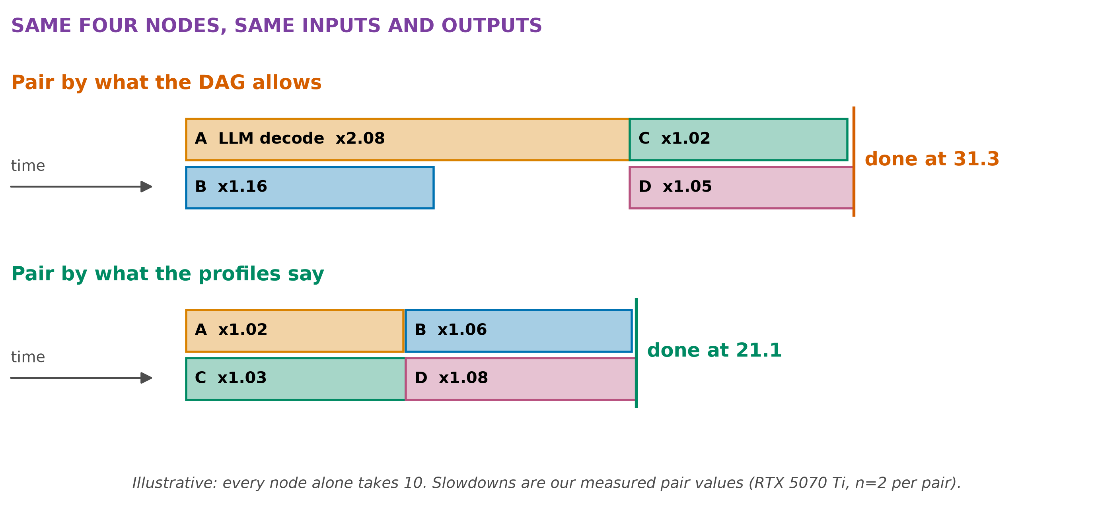
PLANNER IMPACT
Profile-aware pairing finishes 33% sooner (illustrative)
Inputs and outputs allow all four in parallel. Resource profiles pick the pairs
Illustration using our measured pair slowdowns (RTX 5070 Ti, n=2); planner fields: run-plan.md, resource_needs and resource_inventory
11
Notes:
TIME 1:15
SAY: Main points:
- Toy case: four nodes of equal length, measured pair slowdowns
- Pairing LLM with training: 31.3. Pairing LLM with speech and training with NVENC: 21.1
- M1 scheduler runs one node at a time, so the gain starts with M2 parallel branches
- The design already has resource_needs, exclusive mode and resource_feasibility to carry this
- Prior art: Orion (EuroSys 2024) schedules kernels by complementary resource phases
Supplemental points:
- 21.1 vs 31.3 is 33% less; both assume equal solo times of 10
- Run-plan future seams: parallel branches need declared effects, resources and an execution profile

Slide 12
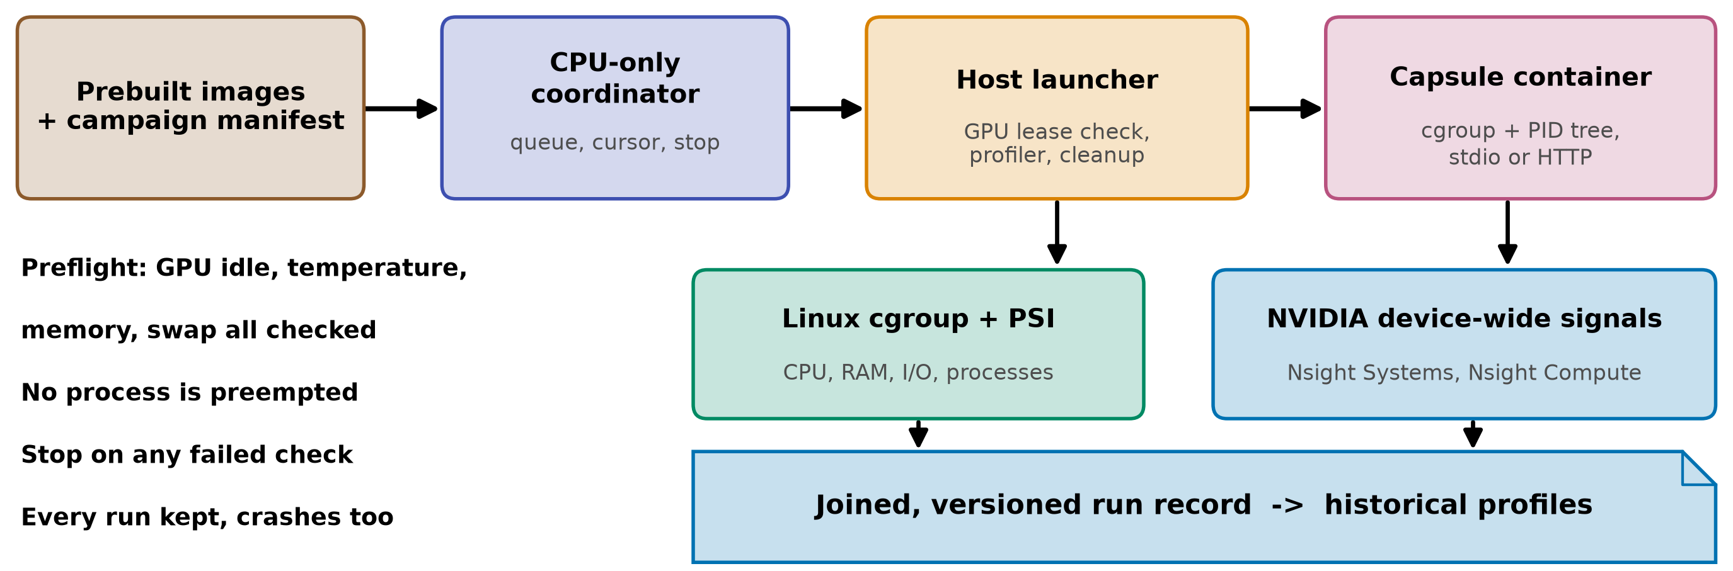
CONTAINERIZED CAPSULES
Pinned containers in an authorized serial quiet queue
The image gives us | It does not give us | Cost and precedent
Digest as executable identity, repeatable environment | Exclusive GPU or deterministic timing | +219 ms per GPU container start (ours)
cgroup and PID-tree accounting | Kernel metrics scoped to the container | Queue pattern: Slurm job arrays
Same packaging unit Paper2Agent proposes | Any change to the capsule declaration | GPU access: NVIDIA Container Toolkit
gb10-profiling-plan.md; NVIDIA Container Toolkit; Slurm job arrays; startup cost: Our measurements, RTX 5070 Ti, n=2 to 12, unaudited: sources/2026-10-16-shared-gpu/report.md
12
Notes:
TIME 1:15
SAY: Main points:
- Containers do not make GPU counters per container, the quiet window does
- Prebuild and pre-pull images outside the window, serial jobs, stop on any failed preflight
- Use spare window time for repeats where variance is highest
- Keep Docker socket out of the capsule, host launcher owns profiler and cleanup
Supplemental points:
- arm64 and amd64 images are different environments and are recorded separately
- AGX Orin study (HiPC 2023): container overhead small for its setup, so measure ours

Slide 13
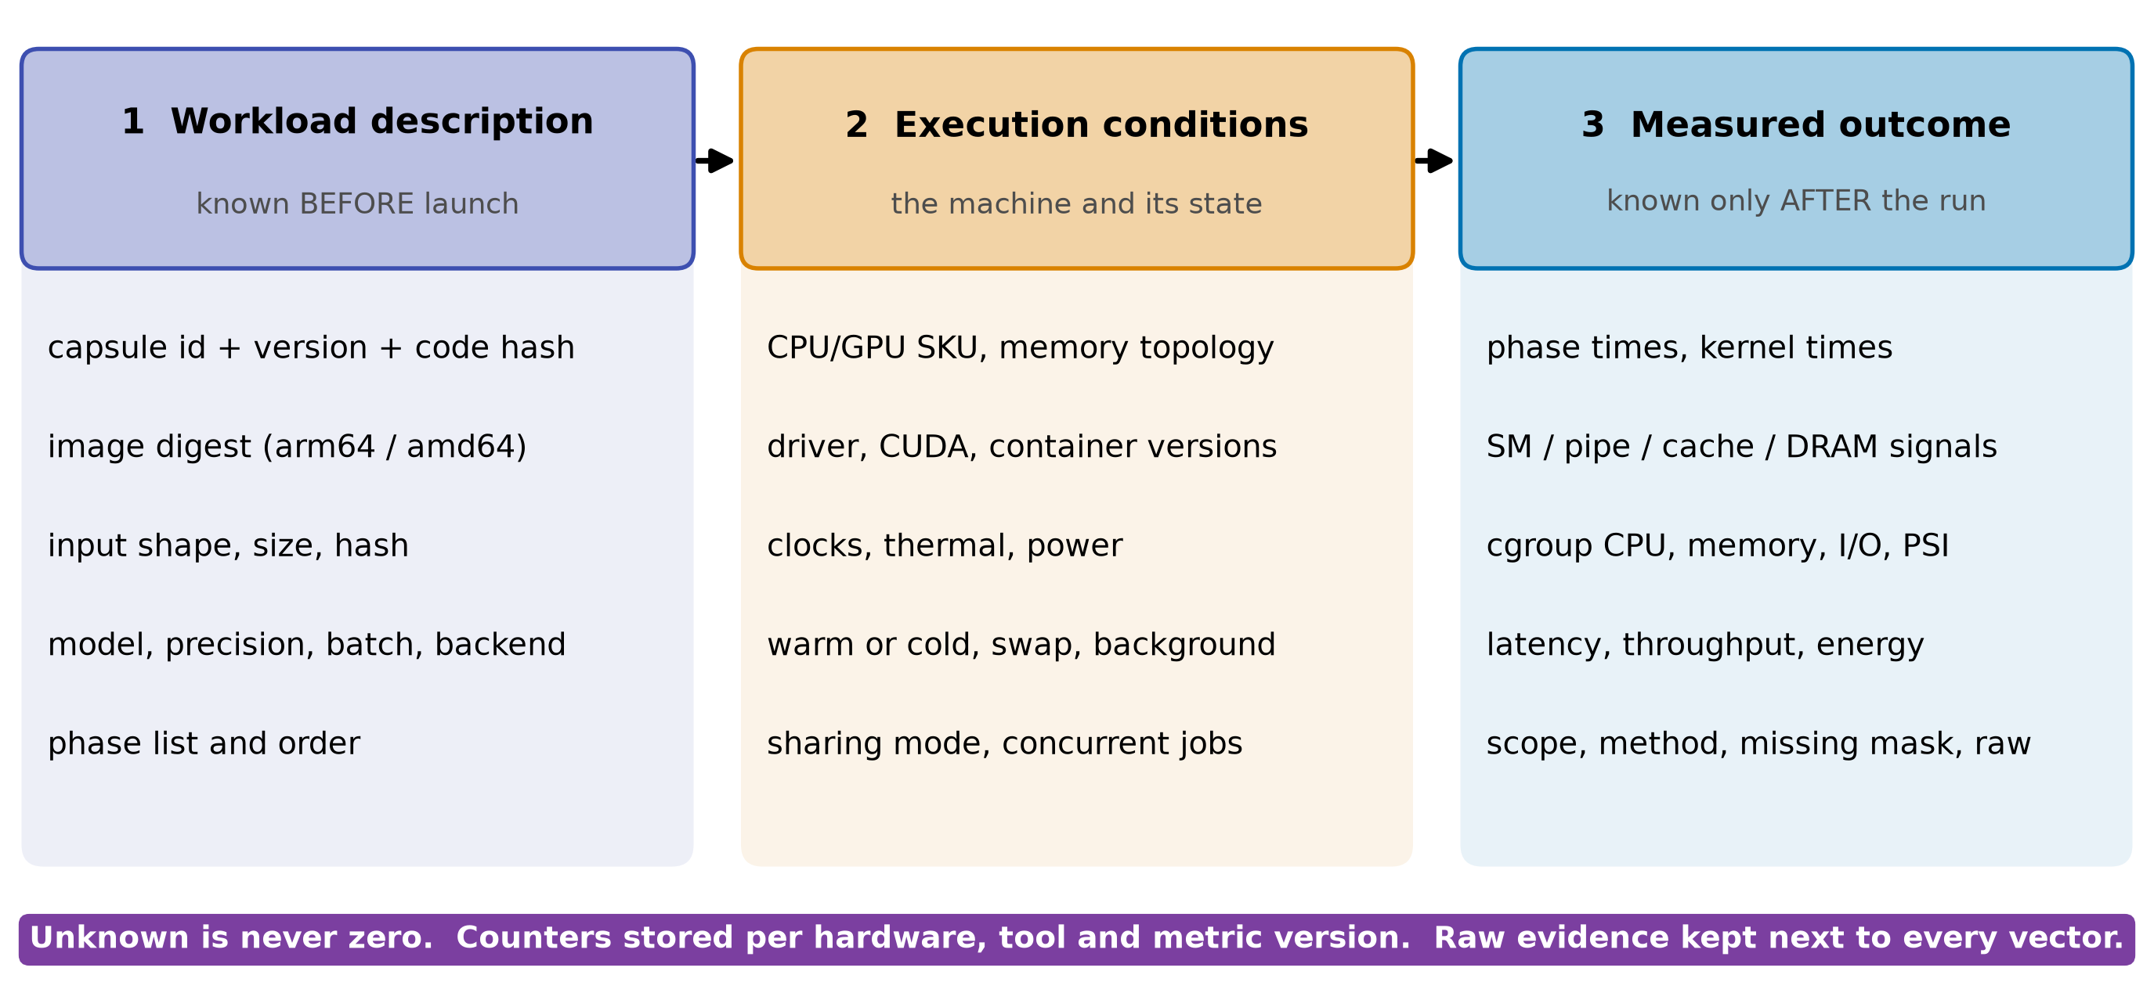
THE RECORD
Three linked records: unknown is never zero
gb10-profiling-plan.md, future data contract; Chakra (MLCommons) as the trace format to reuse
13
Notes:
TIME 1:00
SAY: Main points:
- Description is known before launch and is the only input to pre-launch prediction
- Conditions describe the machine and its state, counters are stored per hardware and tool version
- Outcome is after the run, never an input to the same run's prediction
- Interpretable fields and raw evidence stay beside any embedding
Supplemental points:
- Start with nearest-neighbor on understandable features, compare a learned embedding to it
- Preserve phase order, an average vector hides peaks

Slide 14
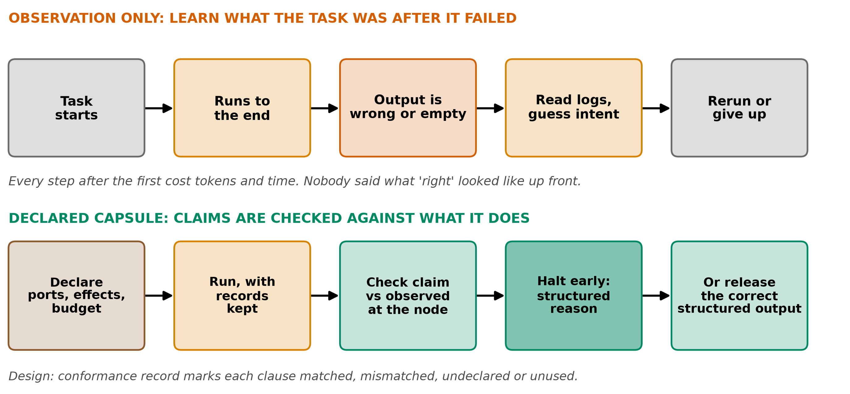
WHY CAPSULES
Check claims at the node, not failures after the run
design-package/reference/derived-records.md (conformance record); checking/README.md
14
Notes:
TIME 1:00
SAY: Main points:
- Without a declaration nobody knows what the task was supposed to do, so a failure is only found at the end
- With one, the node check compares the claim to what was observed and halts or releases structured output
- Early halt should save tokens, that is a hypothesis we have not measured
Supplemental points:
- Conformance record: matched, mismatched, undeclared, unused, unavailable

Slide 15
WHY CAPSULES
Six capsule advantages, each with its status
Claim | Mechanism in the design | Status
Failures are caught or answers are structured | Declaration vs observed behavior, check bundle per node | Designed M1, not built
Failing runs stop sooner and save tokens | Halt at the node, dependents skipped only (D49) | Hypothesis, unmeasured
Work is a DAG of versioned, pinned units | Hashes identify a version, binder pins at freeze | Designed M1
Each capsule is verified alone | Admission with self-tests, then independent evidence | M1 manual, M2 gated
The library grows by itself | RSI proposes a child, hidden fixtures held by a referee | M1 workbench, M2 auto
Runtime behavior can be evaluated | Container profile plus profile records (this deck) | Proposed
design-package: 2-capability-capsules.md, capability-capsules/library-and-checking.md, side-systems/rsi-workbench.md, run-plan.md
15
Notes:
TIME 1:15
SAY: Main points:
- Each claim is tied to a mechanism that exists in the design package
- Status column keeps us honest: none of this is measured on AI4Research yet
- Containerization is what lets runtime behavior join the claim-versus-observed check
Supplemental points:
- Token saving is theory until we run a failing task both ways

Slide 16
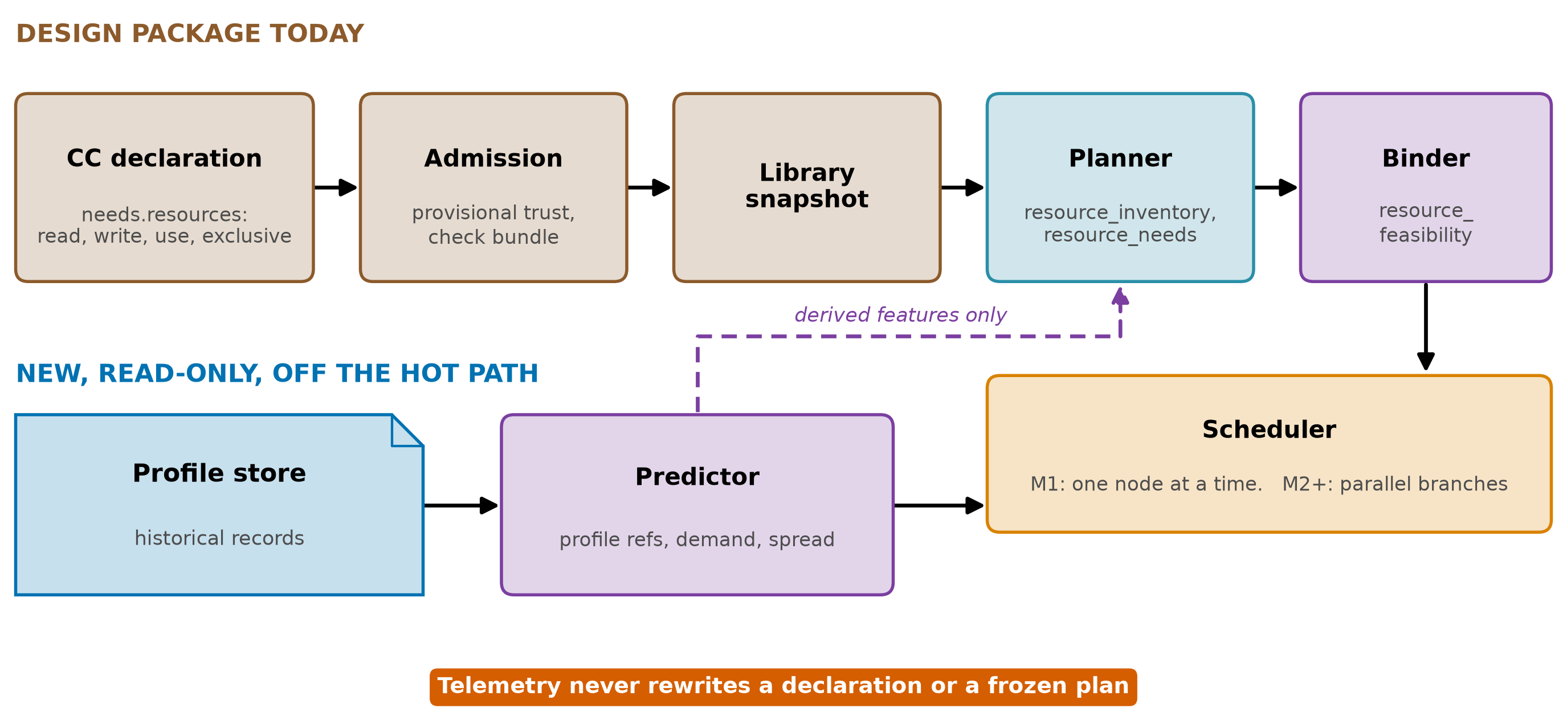
WHERE IT ATTACHES
Profiles feed existing planner fields, never rewrite pins
design-package/reference/run-plan.md (resource_inventory, resource_needs, resource_feasibility, future seams); method/decisions.md D36, D40
16
Notes:
TIME 1:00
SAY: Main points:
- Declarations say eligibility and need, such as one exclusive GPU, not predicted SM or cache demand
- The predictor is a read-only side system off the hot path, like the router and RSI workbench
- It hands derived features to the planner, nothing rewrites a pin
- Peak memory is unmeasured today and the policy ceiling is 32768 MB until the first pilot
Supplemental points:
- Admission could later store a profile as evidence per capsule version

Slide 17
RECOMMENDATIONS
Five things to do, five to avoid, each backed
Do | Backed by | Avoid | Because
Profile solo in exclusive windows | DCGM profiling conflicts with Nsight | Per-container GPU shares from device counters | Counters are device-wide
Key records by image digest and machine | NVIDIA Container Toolkit, OCI | Comparing percentages across chips | Utilization is not headroom
Keep phases: startup, cold, steady | Ours: 64 s vs 5 s, 6 s vs 0.05 s | One averaged vector per task | Averages hide peaks
Pair by resource type | Orion, our x2.08 vs x1.02 | Summing utilization | Time-split fits better
Batch, do not clone, model servers | Ours: 614 vs 258 tok/s | Treating GB10 memory as VRAM | One pool, no VRAM counter
NVIDIA DCGM, MPS, Container Toolkit docs; AWS, Google, Microsoft monitoring docs; Slurm; our report
17
Notes:
TIME 1:15
SAY: Main points:
- Every row names where the idea is already used or measured
- Avoid list is the failure modes we saw in the literature and in our own numbers
Supplemental points:
- Also avoid exhaustive combination sweeps and collecting every counter

Slide 18
NEXT
Smallest unresolved tests to run on the GB10, in order
# | Test | Decides | Status
1 | Probe DCGM, Nsight Compute and cgroup visibility on the GB10 | Which signals exist on this machine | Missing
2 | Solo baselines for a small suite: FP, tensor, DRAM stream, cache, launch-bound | Record schema fields | Missing on GB10
3 | MPS vs time-slicing on the measured LLM + training pair | How much switching cost is removable | Missing
4 | Cold start, JIT cache and model residency on GB10 | Startup phase in records | Done on discrete card
5 | Same cases on GB10 and RTX 5070 Ti | What transfers across machines | Missing
6 | NVDEC and NVENC separated | Media-engine path | No NVDEC data
gb10-profiling-plan.md phases A to D; prebuild-recommendations.md
18
Notes:
TIME 1:00
SAY: Main points:
- Start with sensor validation before any science
- Sharing pairs come after reliable solo profiles
- Ask for approval of the quiet-window protocol and one owner for the GB10 campaign
Supplemental points:
- Set repeat counts from pilot variance, bracket with control runs for thermal drift

Slide 19
Appendix
Tool visibility, cloud practice, GPU map, remaining measurements, literature, limits, sources
Notes:
TIME 0:05
SAY: Main points:
- Backup material, shown only on request

Slide 20
APPENDIX
Clouds collect device metrics; labels need Kubernetes
Provider | Path | What it collects | Attribution
AWS | CloudWatch agent, nvidia_gpu block | nvidia_smi_* utilization, memory, temperature, PCIe, encoder stats | Instance level, needs driver and nvidia-smi
Google GKE | Managed DCGM to Managed Prometheus | 21 metrics: GPU util, SM, FP16/32/64 and tensor pipes, DRAM, PCIe, NVLink, power | container, pod and namespace labels on every metric
Microsoft AKS | DCGM exporter to Managed Prometheus and Grafana | Utilization, memory, temperature, power | Per scrape of GPU node pools
AWS CloudWatch agent NVIDIA GPU page; GKE DCGM metrics page; AKS monitor-gpu-metrics page
19a
Notes:
INSERT: optional slide; delete or hide it and the talk flows unchanged
TIME 0:30
SAY: Main points:
- Same device metrics everywhere
- Only Kubernetes labels give workload attribution

Slide 21
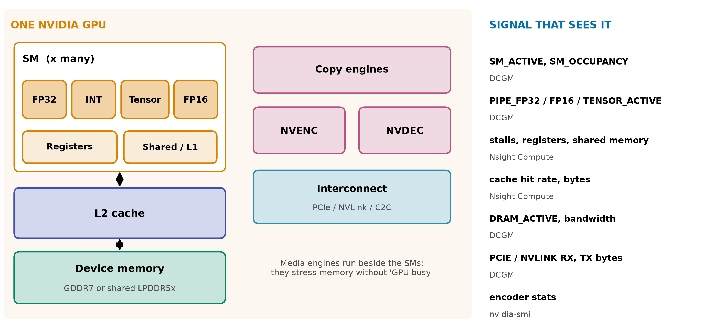
APPENDIX
Six GPU resources, six different signals
NVIDIA DCGM profiling fields (SM_ACTIVE, PIPE_TENSOR_ACTIVE, DRAM_ACTIVE, PCIE/NVLINK bytes); AWS CloudWatch encoder stats
19b
Notes:
INSERT: optional slide; delete or hide it and the talk flows unchanged
TIME 0:30
SAY: Main points:
- Media engines stress memory without raising GPU busy

Slide 22
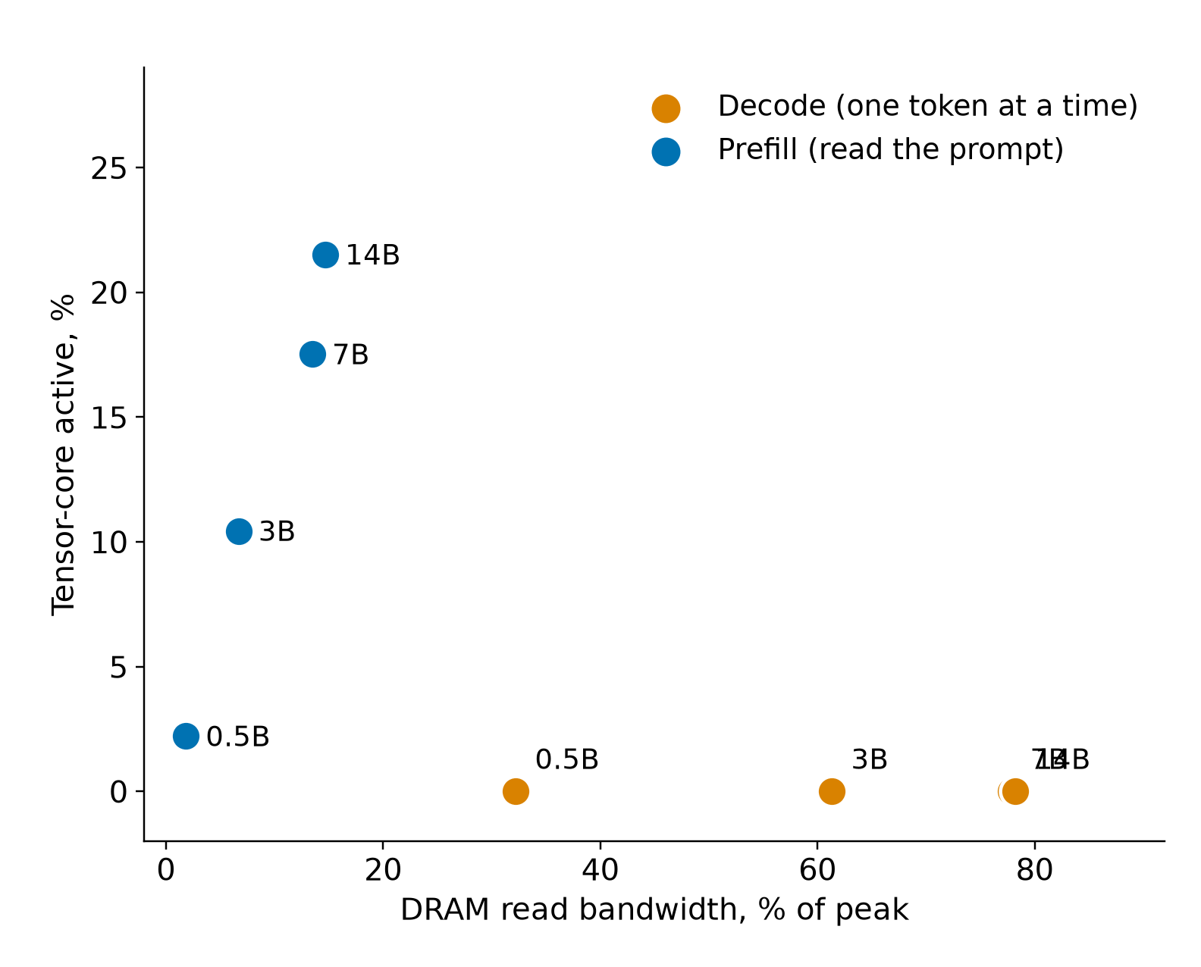
APPENDIX
Decode is memory-bound: 7B hits 95% of the ceiling
Model | Decode tok/s | DRAM | Prefill tok/s | Tensor
0.5B | 738 | 32% | 31,726 | 2%
3B | 283 | 61% | 10,709 | 10%
7B | 157 | 78% | 6,590 | 18%
14B | 80 | 78% | 3,397 | 22%
• Speech-to-text and NVENC: 1 to 3% on every counter
• 7B partial offload: 157 tok/s all-GPU, 22 at 20 of 28 layers
Our measurements, RTX 5070 Ti, n=2 to 12, unaudited: sources/2026-10-16-shared-gpu/report.md (Fig. 8, tables B.3 and B.5)
19c
Notes:
INSERT: optional slide; delete or hide it and the talk flows unchanged
TIME 0:30
SAY: Main points:
- Records need both memory and compute dimensions

Slide 23
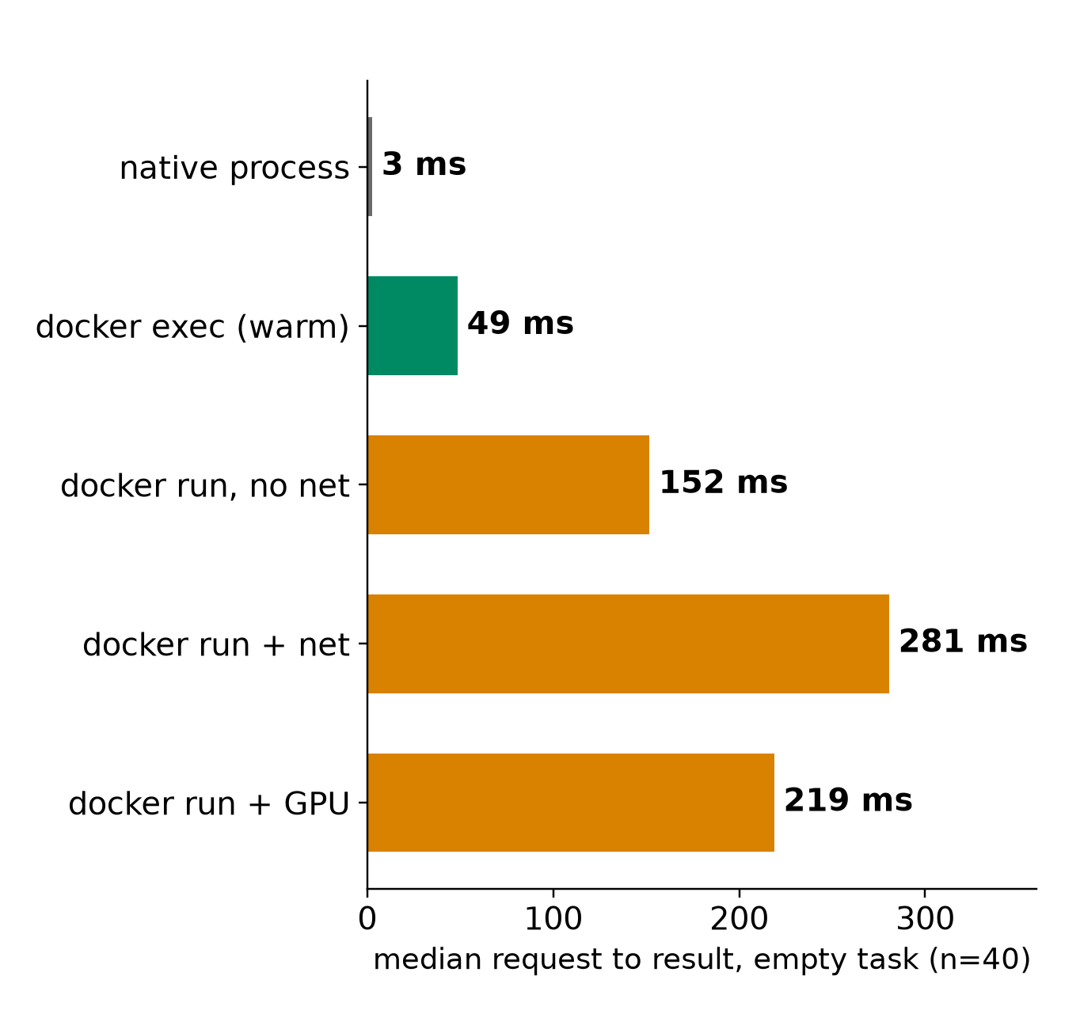
APPENDIX
Startup is its own phase: 219 ms, 64 s vs 5 s
• Overhead is a fixed cost: 339 vs 336 ms with a real 340 ms task
• 16 containers at once: about 2.8x slower each
• Fresh Ollama container: 64.4 s vs 5.3 s with a shared GPU-code cache
• 7B first token: 0.049 s loaded, 2.7 s in RAM, 6.1 s from disk
Our measurements, RTX 5070 Ti, n=2 to 12, unaudited: sources/2026-10-16-shared-gpu/report.md (Fig. 9 to 13, table B.8)
19d
Notes:
INSERT: optional slide; delete or hide it and the talk flows unchanged
TIME 0:30
SAY: Main points:
- Profile cold and warm separately and label which one a record is

Slide 24
APPENDIX
Three prediction claims; prior work covers parts
Claim | Inputs allowed | Cost and risk
1 Before launch | Description and history only | Cheapest, planner can use it at freeze
2 After a short prefix | Plus a bounded profiling run | Report the profiling cost
3 On changed hardware | Plus a hardware model | Needs a validated simulator
Prior work | Reuse | Still open here
Utilization prediction, HotCloud 2020 | Graph features, no per-job profiling | Coarse busy, not per component
NeuSight, ASPLOS 2025 | Tile-level latency across GPUs | Not stress for arbitrary tasks
Orion, EuroSys 2024 | Kernel profiles for sharing | Predicted, not measured, profiles
Interference, SoCC 2025 | Resource sensitivity methods | Unseen tasks
Accel-Sim, ISCA 2020; Chakra 2023 | Simulator; trace format | Calibration on our target
Never feed a finished run's counters back in as an input. Hold out whole task families and hardware
literature/README.md: HotCloud 2020 (Yeung), NeuSight ASPLOS 2025, Orion EuroSys 2024, SoCC 2025, Accel-Sim ISCA 2020, Chakra 2023
19e
Notes:
INSERT: optional slide; delete or hide it and the talk flows unchanged
TIME 0:30
SAY: Main points:
- Reuse code, datasets and trace formats before running new experiments

Slide 25
APPENDIX
What this evidence shows and what it does not
Shows | Does not show
Pairing, batching and cold start effects on one x86 plus RTX 5070 Ti machine | Anything about the GB10 or unified memory
Time-split beats summing for three measured pairs | That MPS removes the switching cost (not tested)
Decode is bandwidth-bound across 0.5B to 14B | Prediction accuracy: no predictor has been built or held out
Container start cost of 219 ms with GPU | Chip-design conclusions: no sensitivity runs
Repeats are small (2 to 12), raw traces and the ledger are still on the other machine | NVDEC behavior, NVENC subtitle path, real agent traffic
Our measurements, RTX 5070 Ti, n=2 to 12, unaudited: sources/2026-10-16-shared-gpu/report.md
19f
Notes:
INSERT: optional slide; delete or hide it and the talk flows unchanged
TIME 0:30
SAY: Main points:
- Everything here was imported from the measuring machine and not independently audited

Slide 26
APPENDIX
Source map
Claim | Source
DCGM device-level profiling, 1 Hz default, conflicts with Nsight | docs.nvidia.com/datacenter/dcgm/latest/user-guide/feature-overview.html
nvidia-smi Memory-Usage Not Supported on DGX Spark; GB10 shares system DRAM | docs.nvidia.com/dgx/dgx-spark/known-issues.html
GB10: 128 GB LPDDR5x, 273 GB/s, 20 Arm cores | docs.nvidia.com/dgx/dgx-spark/hardware.html; NVIDIA Hot Chips 2025 slides
GKE DCGM metrics with container, pod, namespace labels | docs.cloud.google.com/kubernetes-engine/docs/how-to/dcgm-metrics
AWS CloudWatch NVIDIA GPU metrics | docs.aws.amazon.com/AmazonCloudWatch/latest/monitoring/CloudWatch-Agent-NVIDIA-GPU.html
AKS DCGM exporter with Managed Prometheus | learn.microsoft.com/en-us/azure/aks/monitor-gpu-metrics
NVIDIA MPS | docs.nvidia.com/deploy/mps/latest/index.html; GKE MPS guide
Plan, runner shape, record contract | jiuwenswarm/docs/research/resource-aware-planning/gb10-profiling-plan.md
Planner fields and seams | design-package/reference/run-plan.md
Accessed October 2026
19g
Notes:
INSERT: optional slide; delete or hide it and the talk flows unchanged
TIME 0:10
SAY: Main points:
- Source list

